Slide 1




EMS Demand & Capacity Review
Senior Stakeholder Briefing
Hywel Dda (Carmarthenshire, Pembrokeshire & Ceredigion)
Powys
South Gwynedd
MW Joint Committee - Plan for Rural Ambulances / Roster Review Keys
Welsh Ambulance Services NHS Trust

Slide 2

Emergency Medical Services (EMS) 999 Response
– Demand & Capacity Review
Collaborative independent strategic review undertaken by Operational Research in Health (UK company, world leaders in ambulance forecasting and modelling).
Review undertaken on behalf of the Emergency Ambulance Services Committee (EASC). EASC is made up of the seven health boards, who have a responsibility for commissioning ambulances.
Review undertaken in 2019 and formally reported to EASC on 20 Jan-20:- http://www.wales.nhs.uk/easc/january2020
The origins of the Review was the Amber Review commissioned by Welsh Government, and undertaken by EASC:- NHS-Amber-Report-ENG-LR.PDF (wales.nhs.uk)
Amber patient incidents (serious, but not immediately life threatening) is the largest patient incident category accounting for 70% of patient incidents, compared to Red (immediately life threatening) which accounts for 10% of patient incidents. Amber waiting times were too long and there was a system concern about the number of serious adverse incidents for patients (SAIs) in the Amber category.
Welsh Ambulance Services NHS Trust

Slide 3
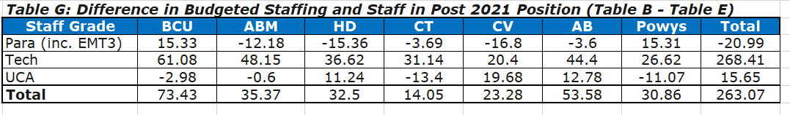
Review Findings (and actions arising)
The Review identified that the Welsh Ambulance Service NHS Trust (WAST) had a gap between the number of full time equivalent (FTE) staff budgeted to fill its Response rosters and the FTEs required to fill the rosters of 263 FTEs, what is referred to as the “relief gap”. EASC has agreed to invest in WAST and close the “relief gap”.
WAST delivered an uplift in FTEs of 136 FTEs in 2020/21 and is on target for a further uplift of 127 FTEs in 2021/22, which will close the “relief gap”. This has been achieved despite the pandemic.
Welsh Ambulance Services NHS Trust

Slide 4
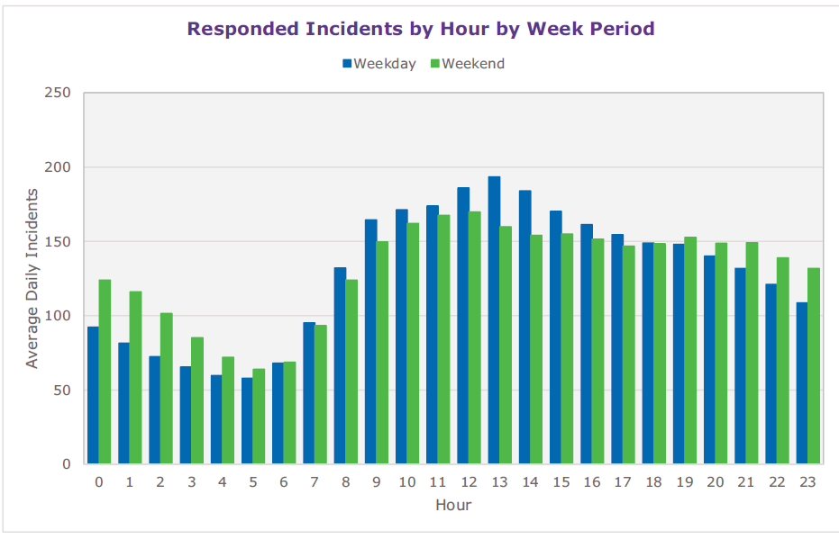
Review Findings (and actions arising)
The Review identified a range of efficiencies for WAST, in particular, re-rostering ambulance resource around the daily demand pattern.
Re-rostering will see a reduction of -56.5 RRVs and an increase of +32 EAs. EAs have a much high utilisation than RRVs and are the ideal resource for Amber patients that need conveying to hospital.
Re-rostering will improve patient waiting times - the Amber 1 90th percentile from 2 hours and 4 minutes to one hour and 18 minutes. Amber is where is the bulk of serious adverse incidents occur.
Welsh Ambulance Services NHS Trust

Slide 5
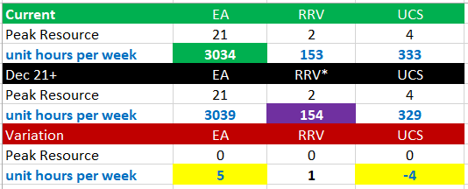
Current V Dec-21 Resourcing – Hywel Dda
The key differences between the original ORH key/Dec 21+ and the revised version are:
No additional growth to RRV and UCS resourcing
This will provide the funded establishment that will be required to ensure no reduction in the EA hours
Overall net gain in resourcing from Dec 2021 with no loss of resources in Hywel Dda
Welsh Ambulance Services NHS Trust

Slide 6
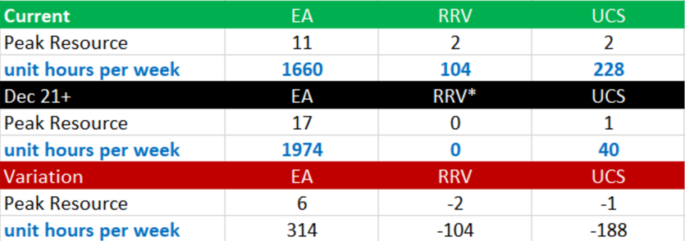
Current V Dec-21 Resourcing - Powys
The key differences between the current resourcing and the ORH key/Dec 21+ resourcing is:
In Powys the planned production will increase by 22 hours per week.
There will be a significant increase of 6 EA at peak (and a reduction of 2 RRVs).
Welsh Ambulance Services NHS Trust

Slide 7
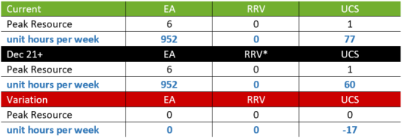
Current V Dec-21 Resourcing – South Gwynedd
The key differences between the current resourcing and the ORH key/Dec 21+ resourcing is:
In South Gwynedd the planned production will in EA will remain the same.
RRVs will currently remain the same will no increase.
The UCS resourcing will be realigned to mid-week demand. This will see a slight reduction on the weekend and an overall decrease of 17 hours per week.
Welsh Ambulance Services NHS Trust

Slide 8
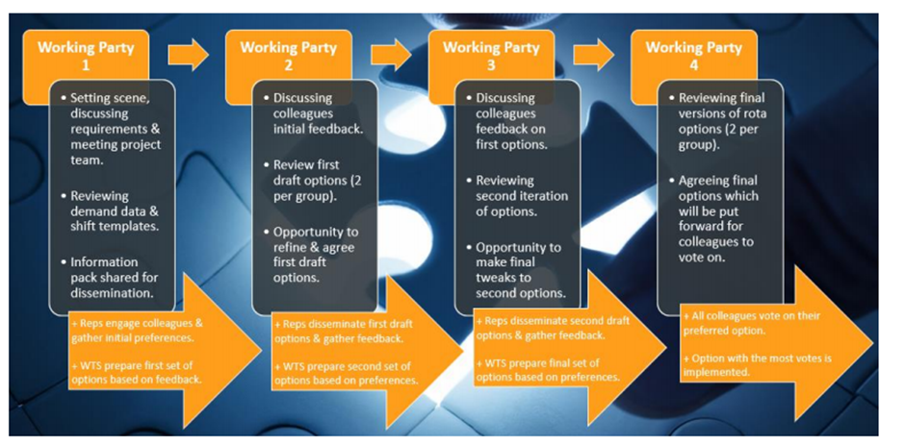
EMS Response Roster Review Project
While there will be no reduction in resourcing, rotas will be aligned to ensure a consistent approach.
The EMS Response Roster Review has the twin objectives of 1) improving patient safety (by delivering rosters aligned to patient demand) and 2) improving staff well-being (by delivering good workable shift patterns).
TU Partners are on the project board and the four stage working party process – there is a high level of engagement – and positive feedback on the approach.
Welsh Ambulance Services NHS Trust

Slide 9
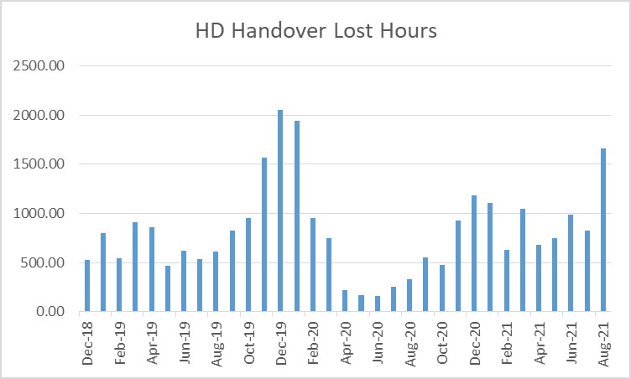
2021 Demand & Capacity Review Update
Closing the relief gap and re-rostering was a first step in a five year programme.
It has always been acknowledged that this first step would not deliver the ambition for patient safety.
An additional 51 FTEs were identified in the 2019 EMS Demand & Capacity Review by 2024. This was predicated on 2018 hospital handover lost hours.
Welsh Ambulance Services NHS Trust
Notes:
Handover in HD in Dec-18 was 523 hours compared to 1,660 hours in Aug-21. We can expect it be higher this winter.

Slide 10
2021 Demand & Capacity Review Update (continued)
Closing the relief gap and re-rostering are the first steps in a five year programme.
It has always been acknowledged that these first steps would not deliver the ambition for patient safety (funding and the ability to recruit are constraints)
The CASC has recently agreed to re-open the EMS Demand & Capacity Review and update it to take account of changing demand and system pressures (handover).
This update will be in two phases, the first part (focusing on Red performance). The second phase will look at Amber.
Welsh Ambulance Services NHS Trust

Slide 11
Key issues and Plans for Powys and South Gwynedd
For the more rural areas trying targeted local recruitment to support staff retention.
Crews often delayed outside hospitals ‘out of area’ result in delayed return to footprint.
Roster review allowing for the realigning of resources during peak demand times, so some reduction off peak.
Ongoing discussions around a rural model for best service delivery.
Concerns around reducing CFRs numbers and the impact.
Senior Paramedics now in roles across the rural area to support with higher acuity patients.
A newly created South Gwynedd Locality Manager in post by Dec 21 to be more locally focussed.
Welsh Ambulance Services NHS Trust

Slide 12
Background Information
– 2019 EMS D&C Review on a Page -
Welsh Ambulance Services NHS Trust

Slide 13

WAST Demand and Capacity Review Recommendations
December 2018
December 2021
December 2024
Budgeted Staff + Sample Period Overtime
Required to fill Rosters
Required for Targets
Position | FTEs
Paramedics | 857.6
Technicians | 372.3
UCA | 198
APP* | 47
Call Handlers | 96.9
CH Supervisors | 3
Allocators | 76
Dispatchers | 66.8
Clinicians | 41
Snr Clincians | 7
Transporting Resource to Solo Responder Ratio
2.5 : 1
Position | FTEs
Paramedics | 836.7
Technicians | 640.6
UCA | 213.6
APP* | 47
Call Handlers | 105.7
CH Supervisors | 18.1
Allocators | 87.6
Dispatchers | 0
Clinicians | 43
Snr Clincians | 6.3
Transporting Resource to Solo Responder Ratio
4.6 : 1
Position | FTEs
Paramedics | 976
Technicians | 746.8
UCA | 246.3
APP* | 72.5
Call Handlers | 106.4
CH Supervisors | 18.1
Allocators | 87.6
Dispatchers | 0
Clinicians | 43
Snr Clincians | 6.3
Transporting Resource to Solo Responder Ratio
7.2 : 1
2.3% demand growth
per annum
2.3% demand growth
per annum
Dept. | FTEs
Frontline | 1,474.8
CCC | 290.6
Total | 1,765.4
Dept. | FTEs | Diff.
Frontline | 1,737.8 | 263.0
CCC | 260.7 | -29.9
Total | 1,998.5 | 233.1
Dept. | FTEs | Diff.
Frontline | 2,041.6 | 304.4
CCC | 261.3 | 0.6
Total | 2,302.9 | 305.0
* Note: APPs modelled are for Response and CCC only and do not include any deployed in primary care.
Measure | Performance
Red 8-minute performance | 72.1%
Red mean Response time | 06:17
Amber 1 mean Response time | 53:05
Amber 2 mean Response time | 115:43
Red 90th percentile Response time | 12:44
Amber 1 90th percentile Response time | 129:13
Amber 2 90th percentile Response time | 292:27
Measure | Performance
Red 8-minute performance | 67.3%
Red mean Response time | 06:46
Amber 1 mean Response time | 34:55
Amber 2 mean Response time | 85:27
Red 90th percentile Response time | 14:06
Amber 1 90th percentile Response time | 78:26
Amber 2 90th percentile Response time | 215:53
Measure | Performance
Red 8-minute performance | 74.2%
Red mean Response time | 05:44
Amber 1 mean Response time | 17:42
Amber 2 mean Response time | 29:44
Red 90th percentile Response time | 12:01
Amber 1 90th percentile Response time | 35:12
Amber 2 90th percentile Response time | 49:09
MONTHLY PERFORMANCE PARAMETERS
ACTIONS
ACTIONS
Parameter | Target | Comments
Red 8-minute performance | 70% Wales 65% HB | With expectation of continuous improvement. Parameters are minimum.
Red 90th percentile Response time | 15 mins (pan Wales) | As per English ARP. See what pan-Wales means at HB level. Improve distribution curve.
Amber 1 mean first Response time | 18 mins (pan Wales) | As per English ARP. To mirror ARP this is a hybrid: 18 minutes if not conveyed, 18 minutes for conveying resource if conveyance required. Model first on scene as per EASC AQIs.
Amber 1 90th percentile first Response time | 40 mins (pan Wales) | As per English ARP. See what pan-Wales means at HB level. Improve distribution curve. Hybrid as above. Model first on scene as per EASC AQIs.
Re-roster planned staff hours
Fill relief gaps in Ops and CCCs
Increase to 10.2% hear and treat
CTLs 30% operational on RRVs
Reduces call backs and call durations as capacity increases
Maintain 18/19 handover hours lost
Increase operational staffing from 2021 re-rostered base
APPs at top locations
Reduce call backs and call durations as operational capacity increases
Increases CT staffing
CTLs 0% operational
Maintain 18/19 handover hours lost
Notes:
December is used in the three points in time above, because it is traditionally the month with the highest demand.

