Slide 1
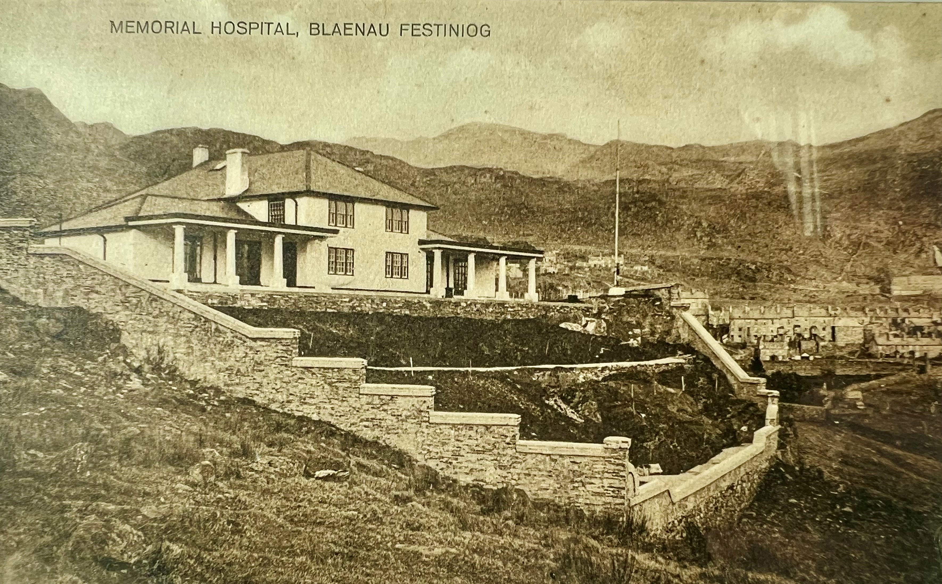
Canolfan Goffa Ffestiniog
Eirian Lloyd-Williams / Keith Amos / Chris Couchman BCUHB

Slide 2
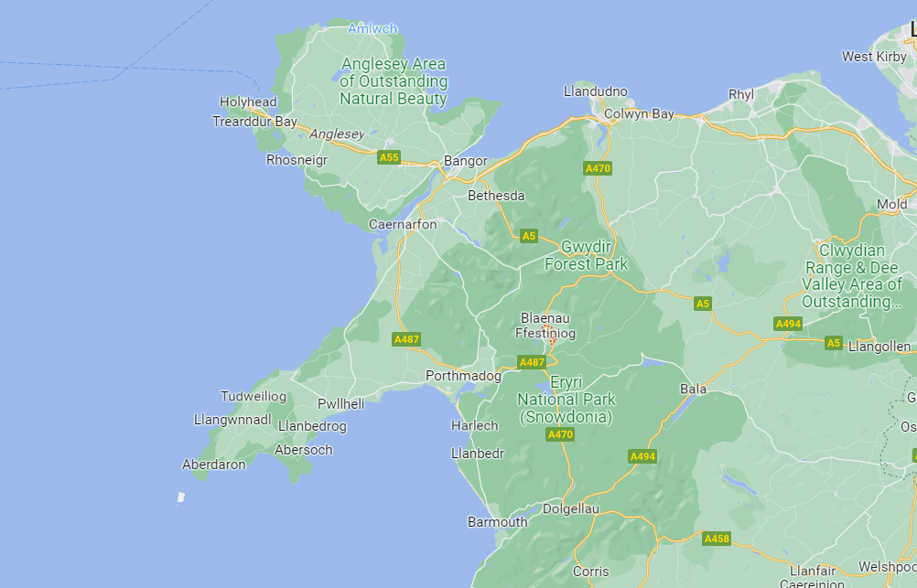

Slide 3
CEFNDIR / Background
Mae Blaenau Ffestiniog yn gymuned wledig a dyfodd o amgylch y diwydiant cloddio llechi, sydd wedi ei lleoli yng nghanol Parc Cenedlaethol Eryri
Mae’r ardal yn nodedig am lefelau uchel o amddifadedd, ac mae ganddi broffil oedran iau na chyfartaledd Cymru
Agorodd Ysbyty Coffa Ffestiniog a’r Cylch ym 1925 i goffau milwyr lleol a fu farw yn y Rhyfel Byd Cyntaf, gyda chyfraniadau gan y gymuned lofaol leol
Cynlluniwyd yr ysbyty gan Clough Williams- Ellis, a hefyd gynlluniodd Portmeirion
Fe ddatblygwyd fel ysbyty cymunedol ar ôl cyflwyno’r Gwasanaeth Iechyd Gwladol ym 1948
Blaenau Ffestiniog is a rural community which grew around the slate mining industry, situated in the centre of the Eryri national park
The area is noted for high levels of deprivation, and has a younger age profile than the Welsh average
Ffestiniog and District Memorial Hospital opened in 1925 to commemorate local soldiers who had died in the First World War, with contributions from the local slate mining community
The hospital was designed by Clough Williams-Ellis, who also designed Portmeirion
It was developed as a community hospital after the introduction of the National Health Service in 1948

Slide 4
ADOLYGIAD GWASANAETH / Service Review
Nododd adolygiad ‘Mae Gofal Iechyd yng Ngogledd Cymru yn newid’ yn 2013:-
  Newidiodd y defnydd o wlâu ysbyty a Mân Anafiadau dros y blynyddoedd diwethaf
  Roedd angen newid mawr ar yr adeilad i wella ei gyflwr ffisegol
  3 adeilad iechyd yn y dref: Canolfan Iechyd (gan gynnwys Meddygfa), adeilad Iechyd Plant / Ffisiotherapi ac Ysbyty Goffa Ffestiniog
Yn dilyn ymgynghoriad cyhoeddus, cytunwyd i ddymchwel yr hen ysbyty coffa ac ailadeiladu canolbwynt iechyd pwrpasol i gartrefu holl wasanaethau iechyd y dref
Trosglwyddwyd cleifion mewnol i Ysbyty Alltwen, Tremadog
Caewyd adeilad yr Ysbyty Coffa yn 2013
`Healthcare in North Wales is changing’ review in 2013 identified:-
  Use of the hospital beds and Minor Injuries changed over recent years
  The building required major change to improve its physical condition
  3 health buildings in the town: Health Centre (including GP Surgery), Child Health / Physio building and Ffestiniog Memorial Hospital
Following public consultation, it was agreed to demolish the old memorial hospital and to re-build a purpose built health hub to house all health services in the town
Inpatients were transferred to Ysbyty Alltwen in Tremadog
Memorial Hospital building closed in 2013

Slide 5
Heriau / Challenges
Nodi’r ystod o wasanaethau a fyddai’n cael eu lleoli o fewn yr Hwb Iechyd newydd, wedi’u llywio gan Ymgynghoriad Cyhoeddus
Gwrthwynebiad lleol i gau’r Ysbyty
Yn aml, cyfeirir at elyniaeth tuag at staff, gan gynnwys y tu allan i’r gwaith
Sefydlwyd Pwyllgor Amddiffyn Ysbytai i herio cynlluniau
Identifying the range of services that would be located within the new Health Hub, informed by Public Consultation
Local opposition to closure of the hospital
Hostility often directed towards staff, including outside of work
Hospital Defence Committee was set up to challenge plans

Slide 6
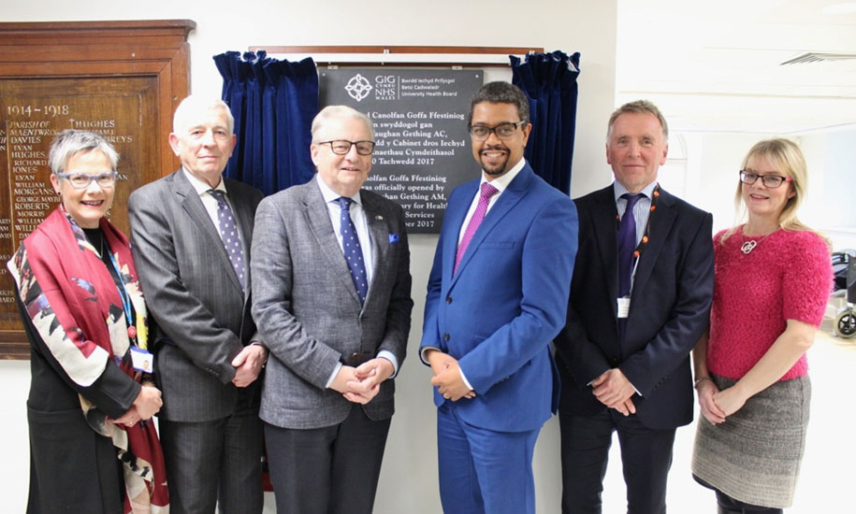
ADEILAD NEWYDD – AGORODD CANOLFAN GOFFA FFESTINIOG YM MIS TACHWEDD 2017
New building – Canolfan Goffa Ffestiniog opened in November 2017
Yn y pen draw, goresgynnwyd gwrthwynebiad lleol trwy ymgysylltu
Dylanwadwyd ar y model gwasanaeth gan adborth defnyddwyr y gwasanaeth, ac mae’r Ganolfan Iechyd bellach yn adnodd cymunedol gwerthfawr
Cadwyd ffryntiau a gardd goffa, ac maent yn dal i gael eu cynnal gan y Lleng Prydeinig
Local opposition eventually overcome through engagement
Service model was influenced by service user feedback, and the Health Centre is now a valued community resource
Frontage and memorial garden were retained, and still maintained by the British Legion

Slide 7
Gwasanaethau ddarparwyd yn yr hwb iechyd / Services provided in the new Health Hub
Awdioleg / Audiology
Ymwelwyr Iechyd / Health Visitors
Nyrsys Ysgol / School Nurses
CAMHS
Rhewmatoleg / Rheumatology
Clinig Cof / Memory Clinic
Ymgynghorydd Pediatrig / Paediatric Consultant
Tylino Babanod / Baby Massage
Atal Cwympiadau / Falls Prevention
Clinig Ymataliad / Continence Clinic
Clinig Deintyddol Cymunedol / Community Dental Clinic
Gwasanaeth Awtistiaeth / Autism Service
Podiatreg / Podiatry
Campfa Ffisiotherapi / Physiotherapy Gym
Anableddau Dysgu / Learning Disabilities
Gwasanaethau Dydd Dementia / Dementia Day Services
Gwasanaethau Retinopathi Diabetig / Diabetic Retinopathy Services
Clinig Iechyd Meddwl / Mental Health Clinic
Camddefnyddio Sylweddau / Substance Misuse
Bydwraig / Midwife
Lleferydd ac Iaith / Speech and Language
Tîm Nyrsio Ardal / District Nursing Team
Gofal Lliniarol / Palliative Care
Nyrs Methiant y Galon / Heart Failure Nurse

Slide 8
dysgu / Learning
Ail-adeiladu perthnasau gyda Chynghrair y Cyfeillion
Annog grwpiau 3ydd sector i ymgysylltu a hyrwyddo eu gwasanaethau o fewn y gymuned – Dref Werdd, Antur Ffestiniog, Gisda, Bro Ffestiniog ac ati
Ymgysylltu â chyrff cyhoeddus eraill
  Canolfan Cyngor ar Bopeth
  Adran Gwaith a Phensiynau
  OPUS
  Tan y Maen – Canolfan Lles Cymunedol
  Sgrinio Retinopathi Diabetig
Perthynas waith cadarn gyda Fferyllfeydd Cymunedol (Moelwyn a Powys Davies)
Wedi ymgysylltu â dinasyddion pryderus e.e. trwy wahoddiad i fod yn rhan o’r Grŵp Cyfranogiad Cleifion
Wedi cymryd rhan yn rhaglen S4C – Helo Syrjeri
Mae dysgu wedi bod yn werthfawr wrth i ni ddatblygu gwasanaethau mewn ardaloedd gwledig eraill
Re-built relationships with the League of Friends
Encouraged 3rd Sector Groups to engage and promote their services within the community – Dref Werdd, Antur Ffestiniog, Gisda, Bro Ffestiniog etc
Engagement with other public bodies
  Citizens Advice Bureau
  Department of Work and Pensions
  OPUS
  Tan y Maen – Community Wellbeing Centre
  Diabetic Retinopathy Screening
Great working relationship with Community Pharmacies (Moelwyn and Powys Davies)
Engaged with concerned citizens e.g. through inviting to be part of the Patient Participation Group
Took part in S4C – Helo Syrjeri programme
Learning has proved valuable as we undertake service development in other rural areas
Notes:
https://vimeo.com/user91445929/review/393454396/a58e9812c0
Password: Stiniog

Slide 9
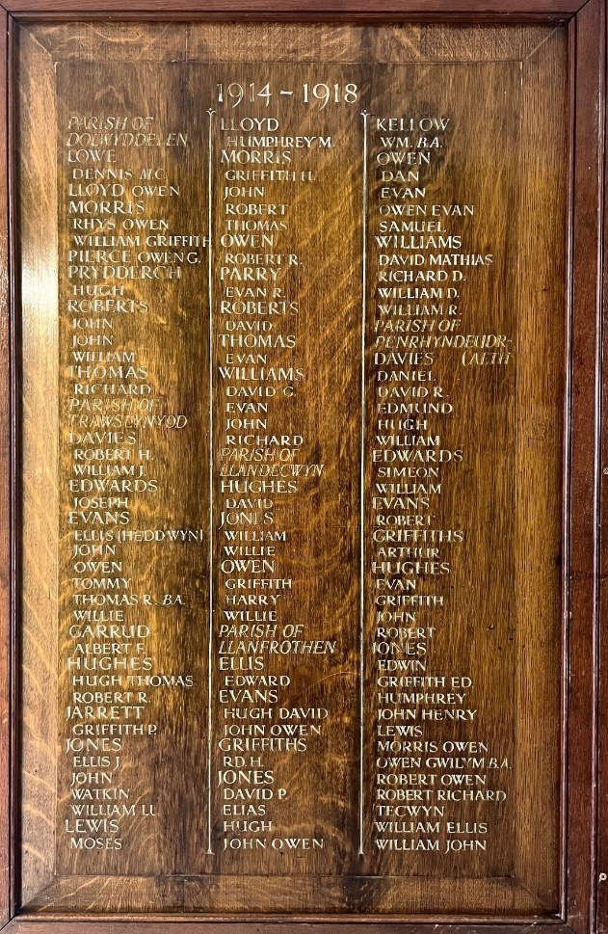
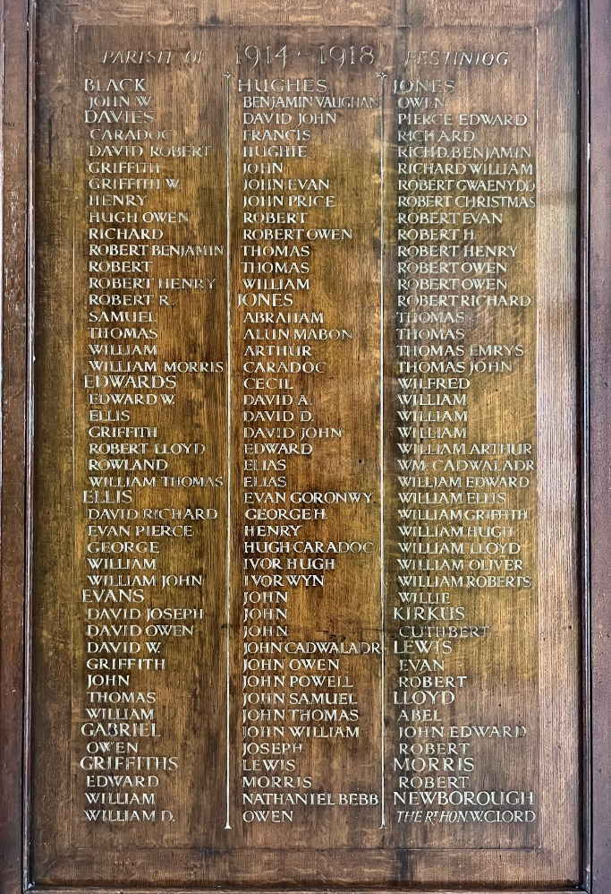
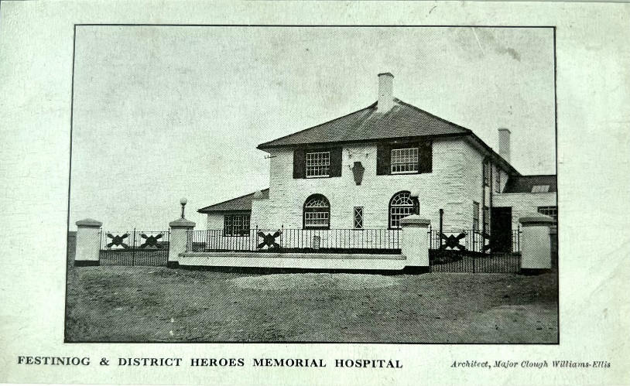
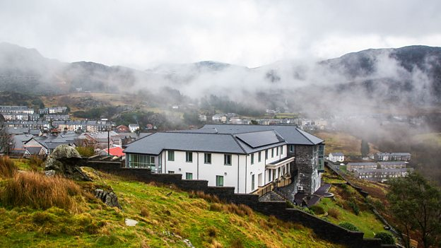
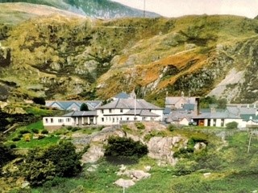
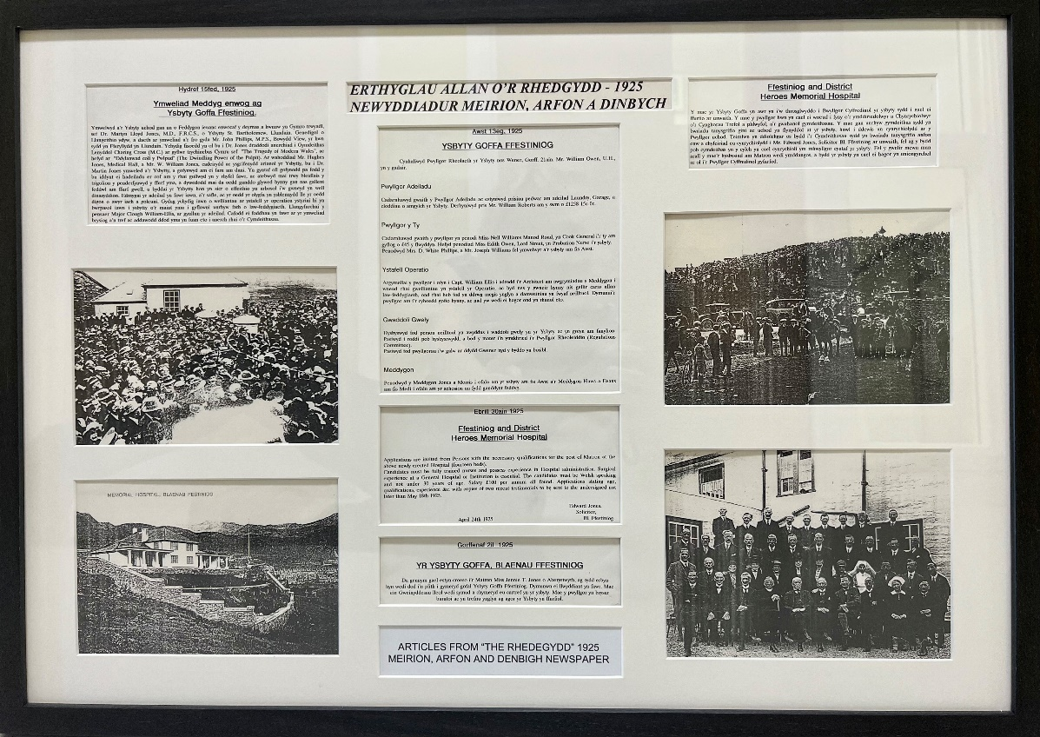
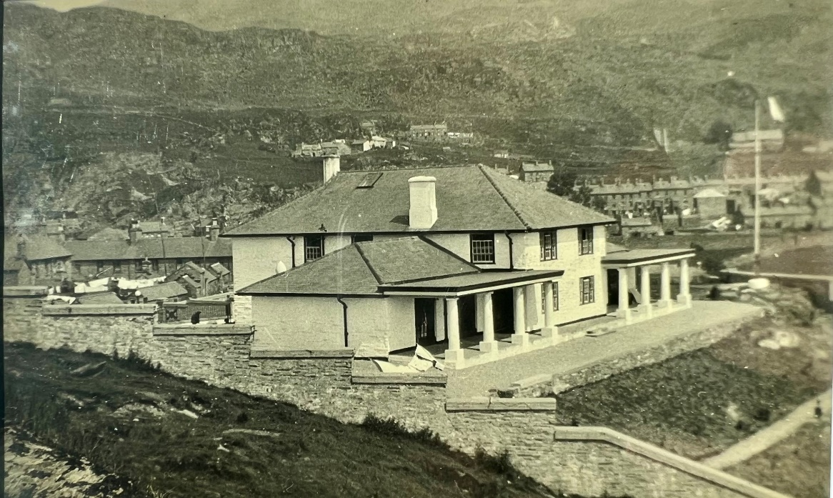
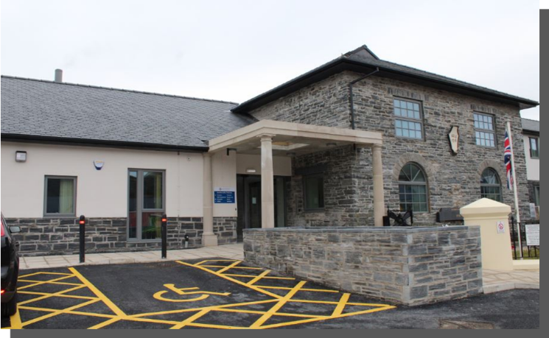
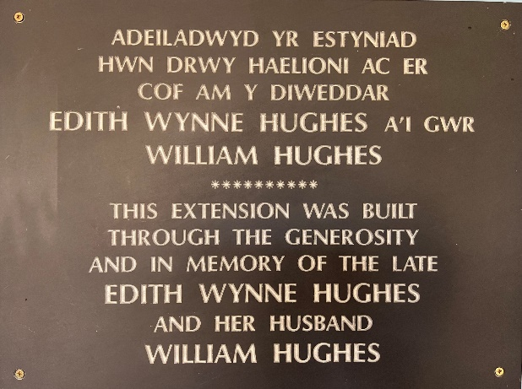
Diolch yn fawr / Thank you

