Slide 1





Radical Powys
Brave Powys
Paul Buss PTHB Director of Clinical Strategy
Amanda Edwards PTHB Assistant Director Innovation & Improvement

Slide 2
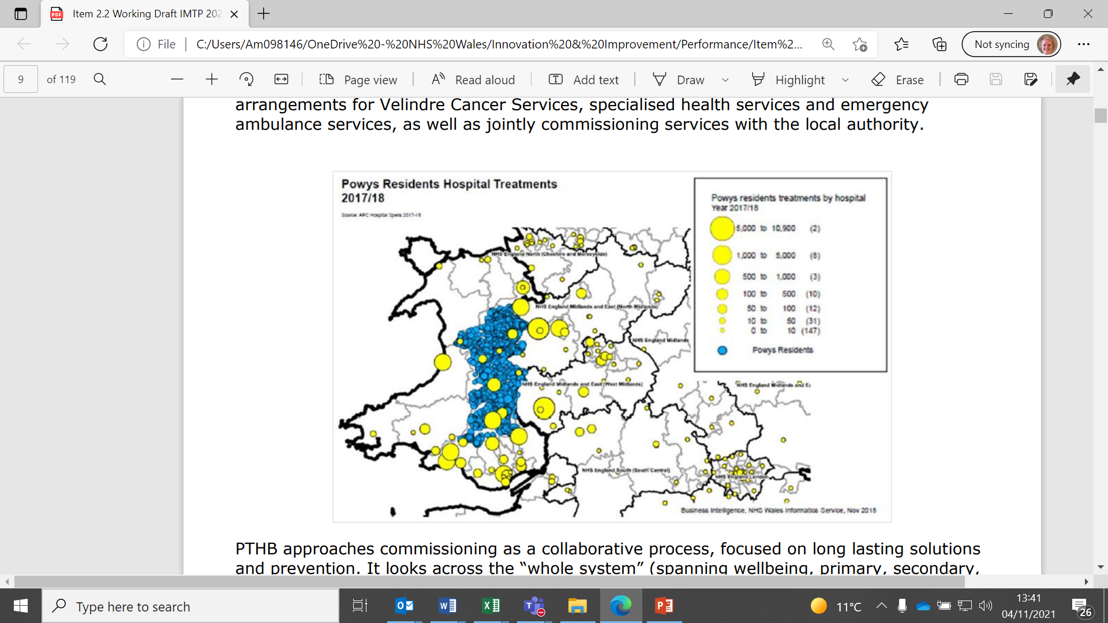




Complexity of PTHB – Rural Health and Care
Powys predominantly rural in character, covering a quarter of the land mass of Wales but only 5% of the population.
It is the most sparsely populated county in England and Wales, with just 26 people per square kilometre.
Rural, primary care, local delivery.
No DGH - Secondary care commissioned services,
Collaborating with 15 other organisations across England and Wales
Expenditure predominantly in services which are not directly managed
Whole system strategy – from the perspective of primary, social Health & Wellbeing
Challenge of equity in dispersed communities
Evidence based opportunity to learn what’s working well across borders

Slide 3


Value Based Health Care (VBHC) – the clinical context:
Reversible loss of sight increasing in Wales
Nationally – many on waiting lists for assessment and treatment
Workforce constraints – limited pool of skilled professionals with:
Increasing our potential to treat and manage eye conditions – e.g.
      Cataracts
      Wet AMD
      Glaucoma
A need to understand our service better from a value perspective
Stipulate what elements we can work on and achieve even better care and broader access and increased productivity
Value Team: Analysis of service by activity, referrals and cost-data

Slide 4
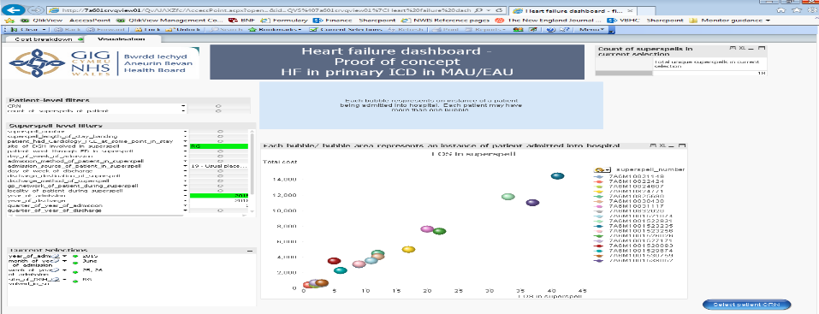
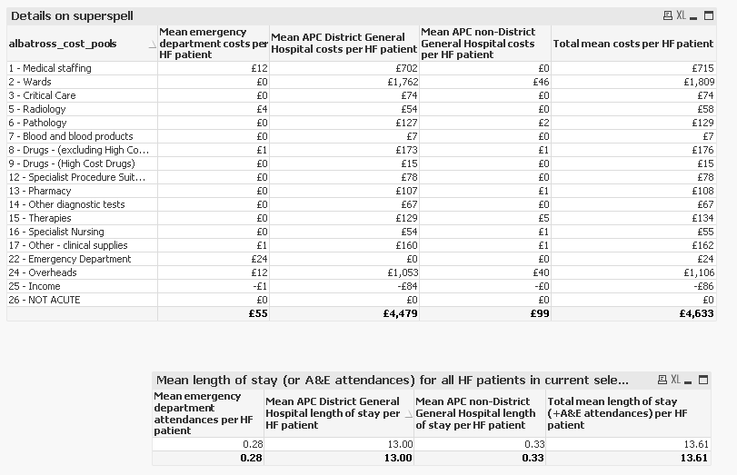
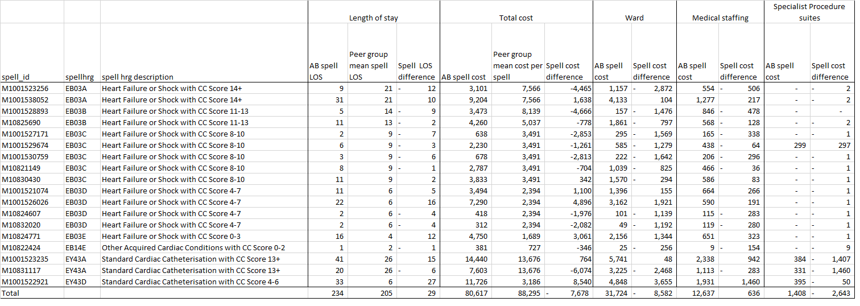
Creating Value, BI, clinical-evidence - “analysis of domains”
Emerging Value Opportunities in eye care:
1. AMD
2. Cataract surgery:
  Governance
  Commissioning
  Treatment offers
  Procurement
  Outcome drivers
  Potential for Innovation in community!!!
  * Theatre efficiencies
  ** TDABC
  Opportunities identified:
  Cash releasing
  Capacity Releasing
  Quality Improving
  Short term and long-term redesign??
  3. MSK (Shoulders)
  Do we need medical model?
  How to best deploy therapists?
  When Can we use Apps/Digital early?
  Using less medication and diagnostics?
  Making fewer referrals?
  Proms impact on future decisions?

Slide 5
Value-based HC Opportunities – Cataracts
Analysed data for cataracts pathway (Powys-provided and commissioned services), building on previous Time Driven Activity Based Costing -work and identified the following opportunities:
One-stop shop:
  assessment, biometrics and pre-op during one visit, avoiding duplication & freeing capacity
  potential to treat bilateral cataracts where clinically appropriate and safe for patient to return home that day
Increasing value within Powys-managed service:
  improved theatre utilisation through adjusted listing and preparation processes
  improving standardisation in theatres to avoid unnecessary variation whilst maintaining quality
  potential for repatriation through additional capacity released above
Cataract opportunities and proposed implementation plan to be considered by Exec Committee in 2023.

Slide 6
Value-based HC opportunities – Wet AMD
Analysed Wet Age Related Macular Degeneration (Wet AMD) pathway and identified opportunities including:
  Strengthening governance -starting, suspending and stopping treatment in line with outcomes
  Moving Powys-managed patients/supporting commissioned providers to move patients from Lucentis to Ranibizumab biosimilar (Ongavia)
  Using the benchmarking costs to renegotiate Long Term Agreements with higher cost providers, using the national tariff as a guideline
  Provide more in Powys: repatriating services in the medium and long-term
  Improving outcome collection in line with recommended standards in order to help plan services maintain highest standards through better knowledge of outcome/data
  Explore opportunities to collect outcome data including assessment of visual acuity using innovative digital solutions.
Exec Committee has approved the implementation of the opportunities identified through a phased work plan (which will be supported by educational events and engagement in other quality initiatives).

Slide 7
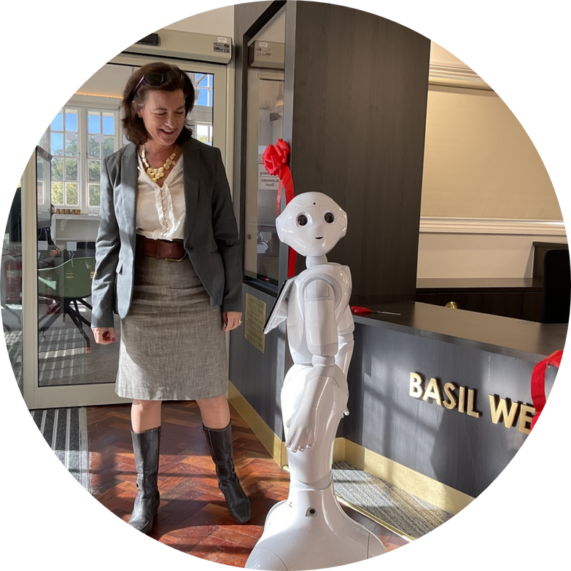
Powys, Better Together
Develop our reputation and raise our profile to become a leader in rural health and care research, testing the application of innovations in a rural context
Focus our efforts to make the biggest difference for the people of Powys creating an environment that fosters research and puts it into practice, testing new innovations and supporting the use of evidence in decision making.
Maximise opportunities to build research activity and capacity, to ensure delivery of evidence-based health care and to contribute to developing the evidence base where evidence is limited

Slide 8




























Powys Eco System

Slide 9
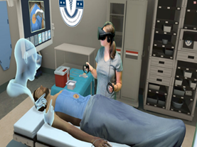

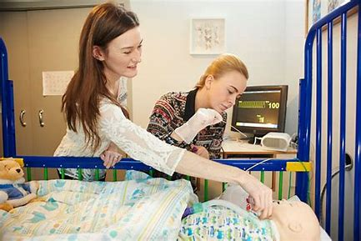
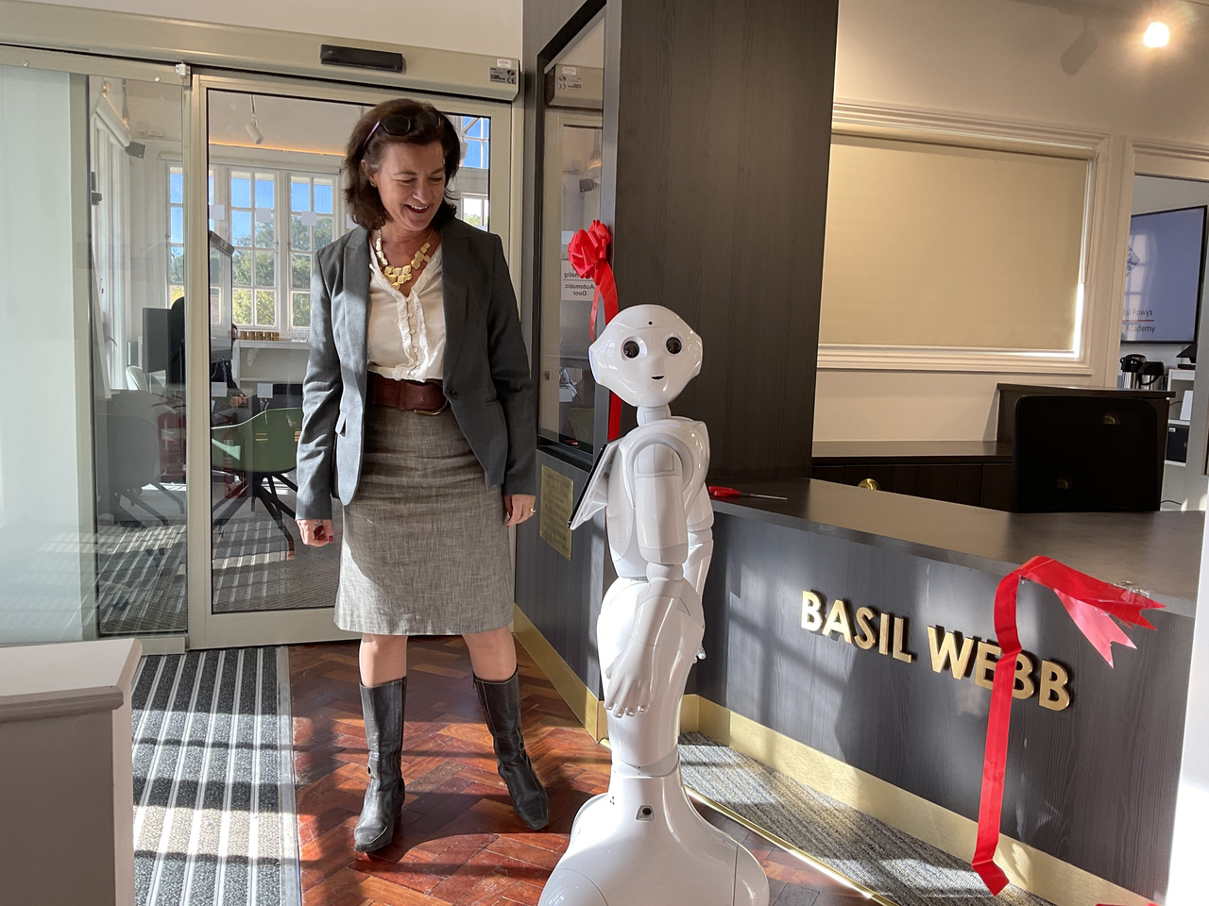
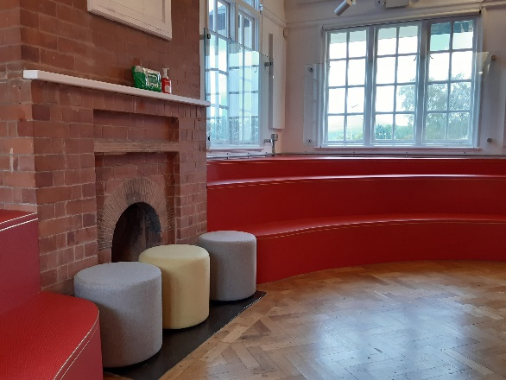

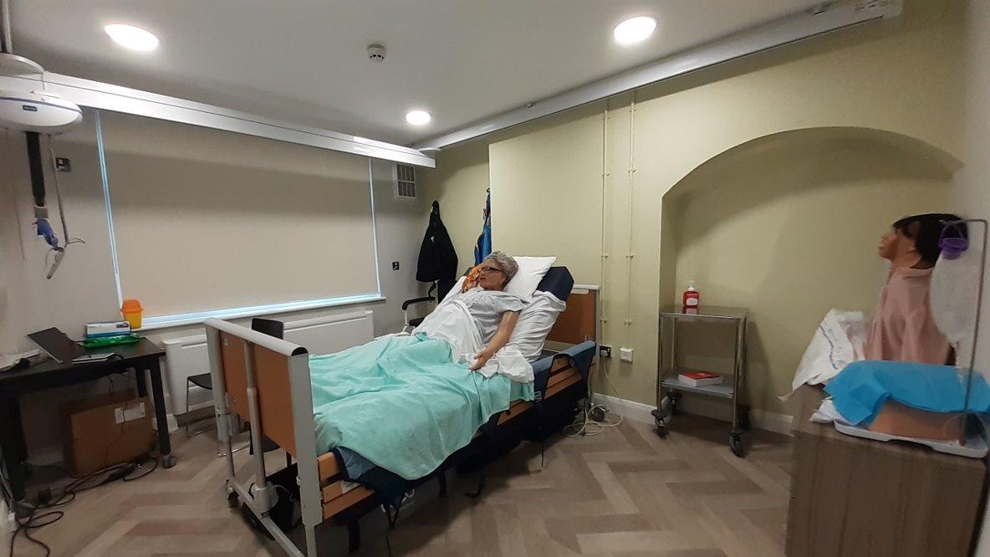
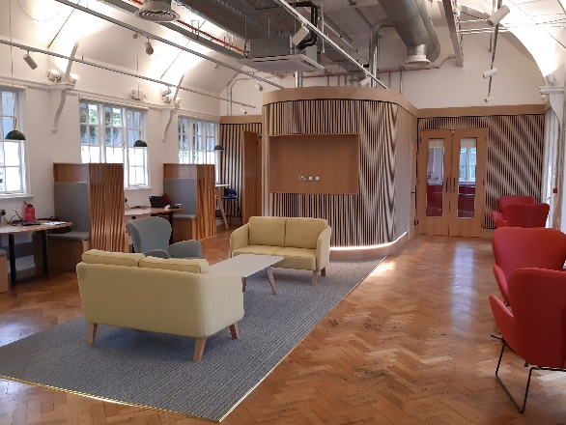

Powys Health and Care Academy
Powys Health & Care Academy
South Powys
North Powys Wellbeing Campus
WIDI Technology Village
Mid Wales Spoke 2023 / 24

Slide 10
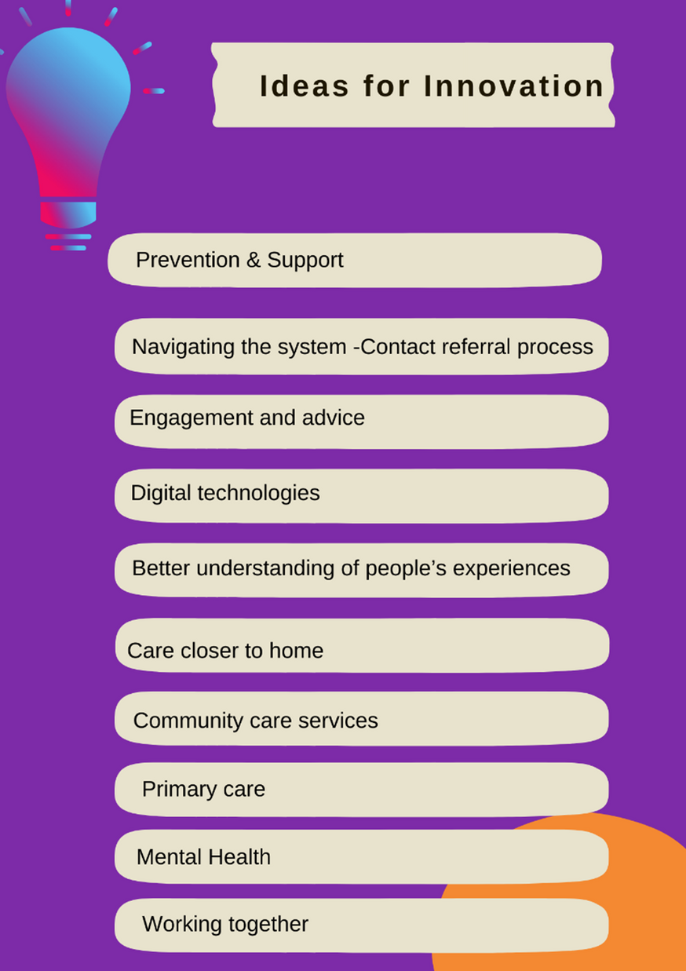
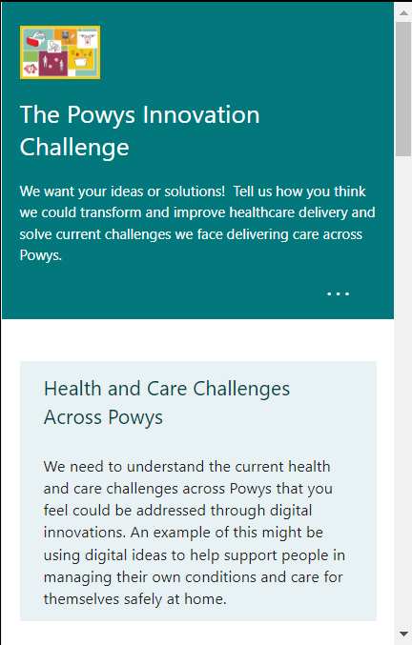


Accelerated Sustainable Model for Health and Care
  Quality embedded across the health & care system
  Work on improving value is whole system (including partners such as the local authority, care homes and the Welsh Ambulance Service) and is taking place along the whole pathway of care.

Slide 11




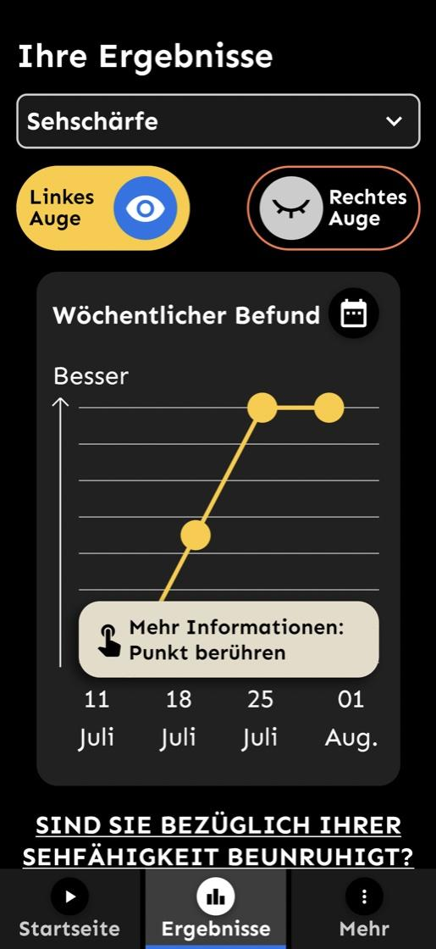
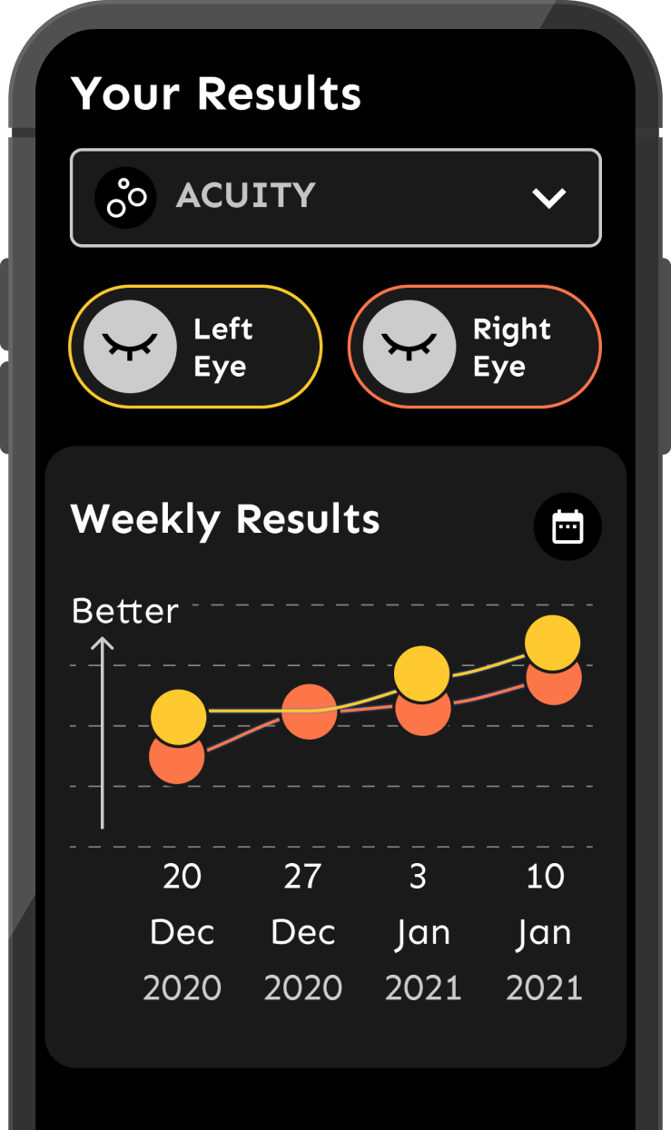

OKKO Health features:
Measurement of vision
Education module
Symptom collector
Treatment logging
Data visualisation
Push notifications
Visual acuity
Distortion
Monitoring

Slide 12


  Innovation to improve eye-care across Powys and rural communities– the key questions:
    Can we reliably mobile technology to assess patients in the place of residence?
    Can we utilise work with volunteers to as “guardians of eye care” to help deploy this.
    Can measurements be reliable and comparable to regular/standard care?
    How might this improve future data collection/utilization?
    Can this tool free up valuable specialist time across all levels?
    Working with OKKO – can this technology expand into other areas?

Slide 13
Where Next?

Slide 14

Diolch Yn Fawr

