Slide 1


Transformation with Digital at the Heart
November 2023

Slide 2

The Challenge
The Transformation programme will aim to help organisations move from the current position, where each holds separate records for the individuals they care for, to one where an individual’s records are connected across the health and care system. This will help professionals to share information safely and securely as well as enabling service users to access their record, irrespective of which part of the system has provided them with their care.
To support acceleration of this work, we have begun to demonstrate how appropriate and compliant information sharing directly improves the quality and efficiency of care while reducing health inequalities. This will provide a blueprint for further work.

Slide 3

Setting the scene
Digital enablement of health & care provision is key to supporting the regional ambition for Hywel Dda, to further:
Create a truly integrated and resilient health and care service, supporting the needs of the Hywel Dda region.
Provide citizen-led connected pathways, unlocking new digitally-enabled ways of working, improving outcomes for all in a financially sustainable way.
Empower citizens to stay healthy and well, addressing inequalities and providing proactive and appropriate care at the right time and place.
During today’s session we will explore how digital enablement can support
Hywel Dda UHB’s ambitions and unlock positive patient outcomes.

Slide 4
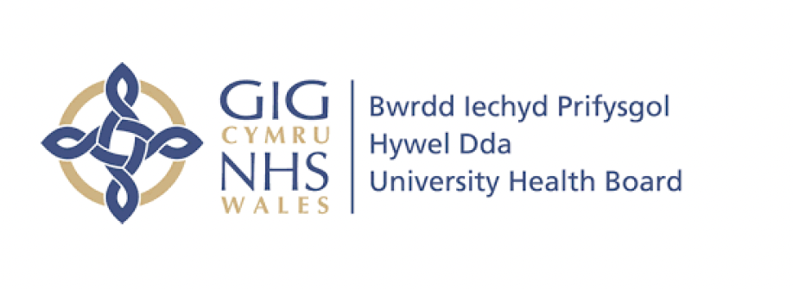
Where are we now?
Phase I: We asked CGI to help us assess our readiness for whole system thinking engaging with our partners in local authority and with us, our teams and our frontline.
We received the results of that assessment in August 2022.
Phase II: We asked CGI to support us in the development of a digital enablement plan to enable us to practically deliver A Healthier Mis and West Wales; Our Future Generations Living Well strategy
We received the results of that assessment in January 2023.

Slide 5
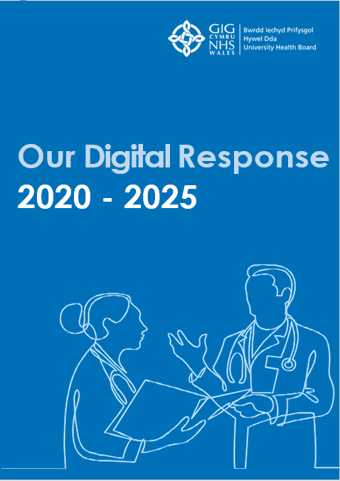
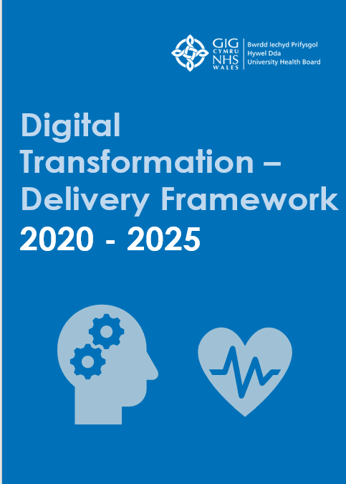
We worked with CGI to help assess readiness for whole system thinking engaging with partners in local authority, our teams, and our frontline.
What’s happened so far?
We set out our Health and Care Strategy - A Healthier Mid and West Wales: Our future generations living well.
This established HDUHB’s shared vision: We want everyone to live healthy lives, full of joy, purpose and feeling like they belong.
To deliver on our Health and care Strategy, we created ‘Our Digital Response’. This set out our commitment to improving digital technology in the Health Board over the next five years in response to the Health Board’s strategic objectives. This response will help us to meet the strategic vision of working together to drive excellence in care for HDUHB’s patients and communities.
We then asked CGI to support in the development of a Digital Enablement Plan to enable HDUHB to practically deliver A Healthier Mid and West Wales; Our Future Generations Living Well strategy
34 Strategic Business Imperatives were identified, providing the strategic direction to enable and focus change in the areas that will have the most impact for HDUHB.
Delivering our ambition for the people of Mid and West Wales, supported by a Digital Strategic Partner
2018
2019
2020
2021
2022
2023
2024 & beyond
Covid-19 provided a catalyst for rapid change in ways of working. For health care services, technology meant that HDUHB could keep patients and staff safe through doing things very differently than many could have ever imagined. The adoption of tools such as Microsoft Teams have enabled mass agile working, equipping staff to communicate with one another remotely.
The Strategic Business Imperatives directed attention to 4 Core Digital Pillars as the focus for transformation and 10 Delivery Projects required to deliver our ambition
We revised our Patient Vision. By digitising the complete care pathway, from admission through medicines administration and onto discharge, patients will receive better and safer care.
We have changed our mindset away from technology being the barrier to achieving better outcomes, towards a focus on how we can leverage the change with people and improve adoption resulting in better outcomes and value

Slide 6
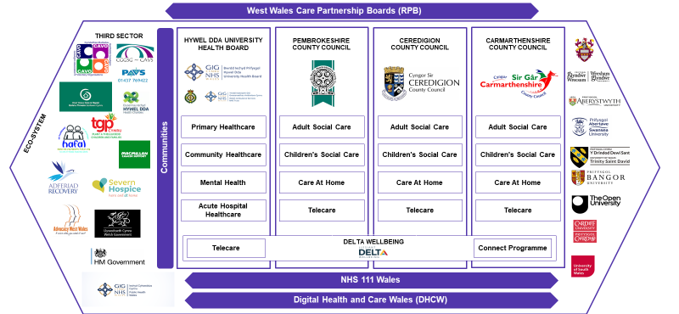
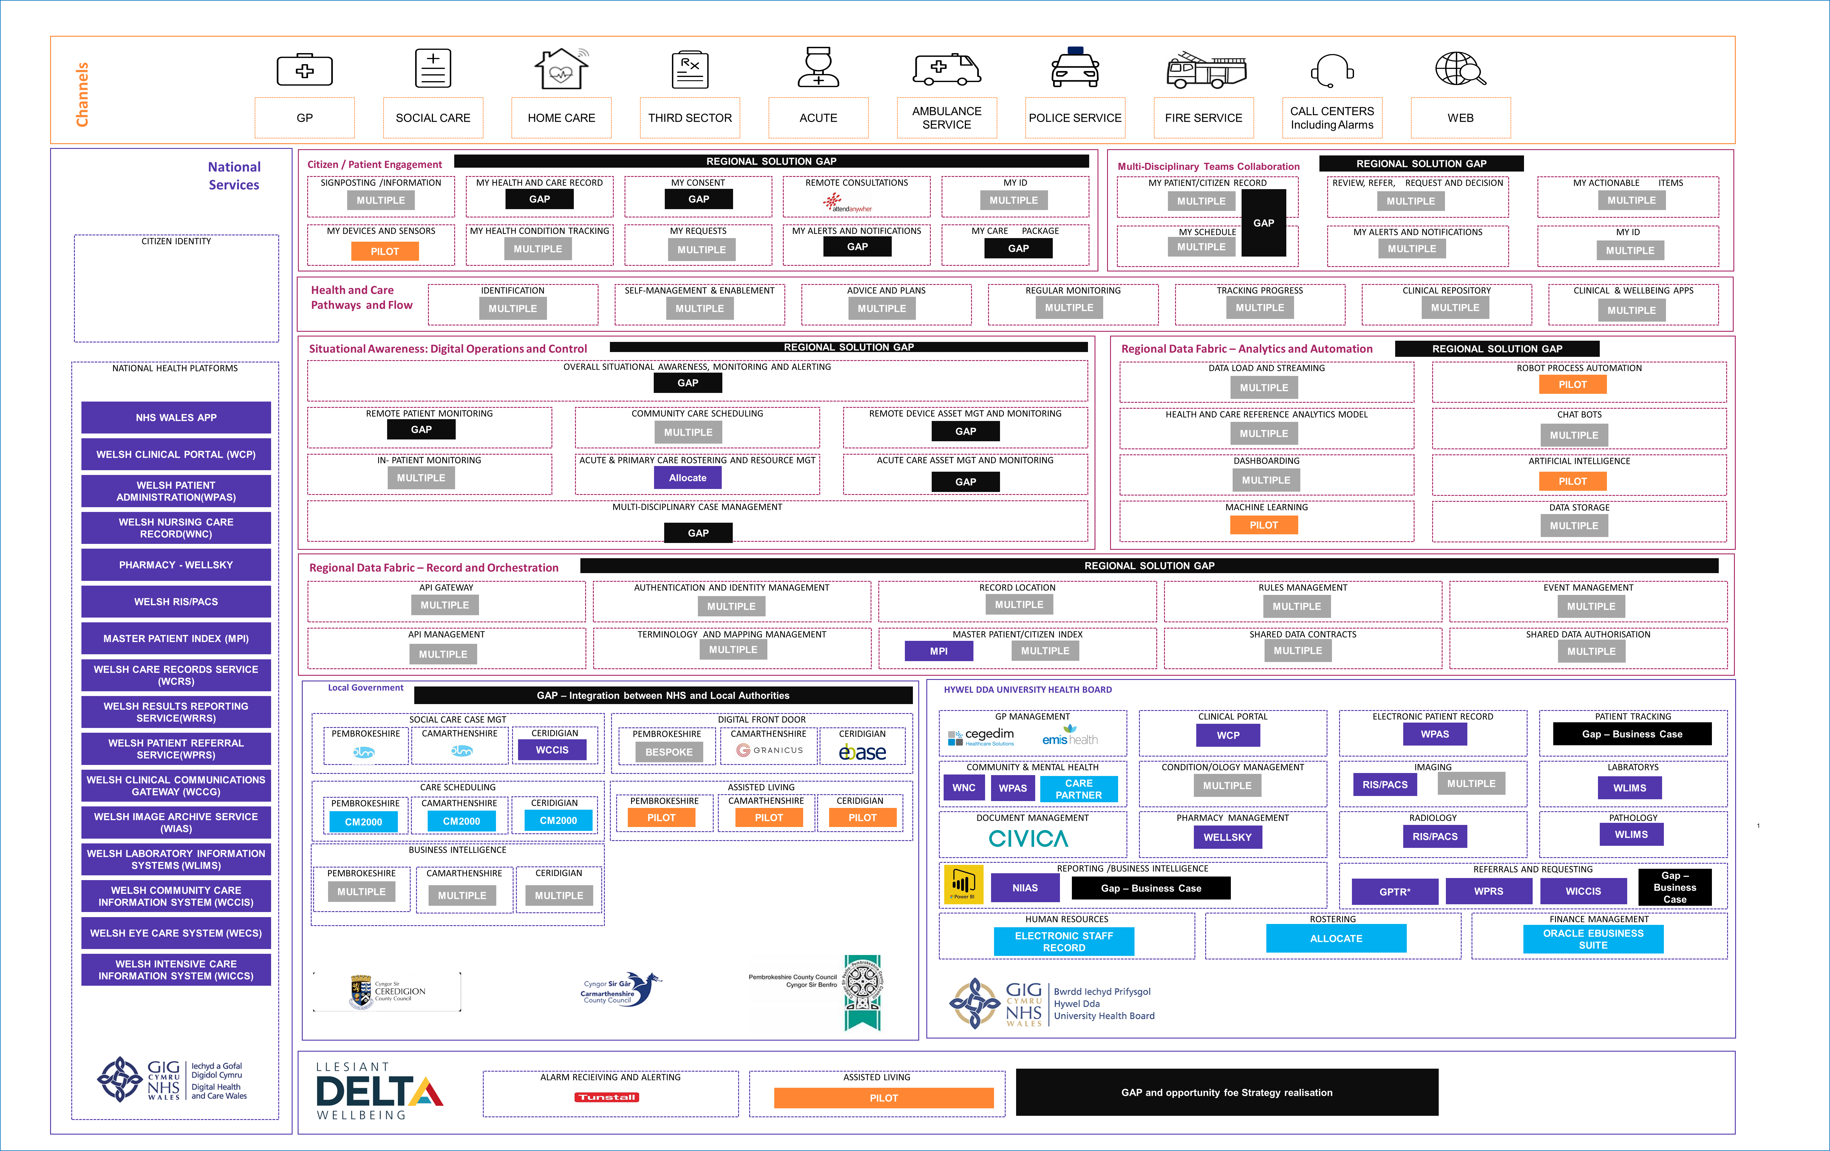
Starting the Transformation Journey - Complexity
To enable fully a digital integrated health and care service for Mid and West Wales and realise the benefits we need to understand the current position and starting point of the journey, and to document what needs to be done organisationally and digitally to achieve the vision.
We have established a base current state architecture for the region we serve
We have mapped across our regional partnership board organisations where we have multiple solutions and key gaps

Slide 7
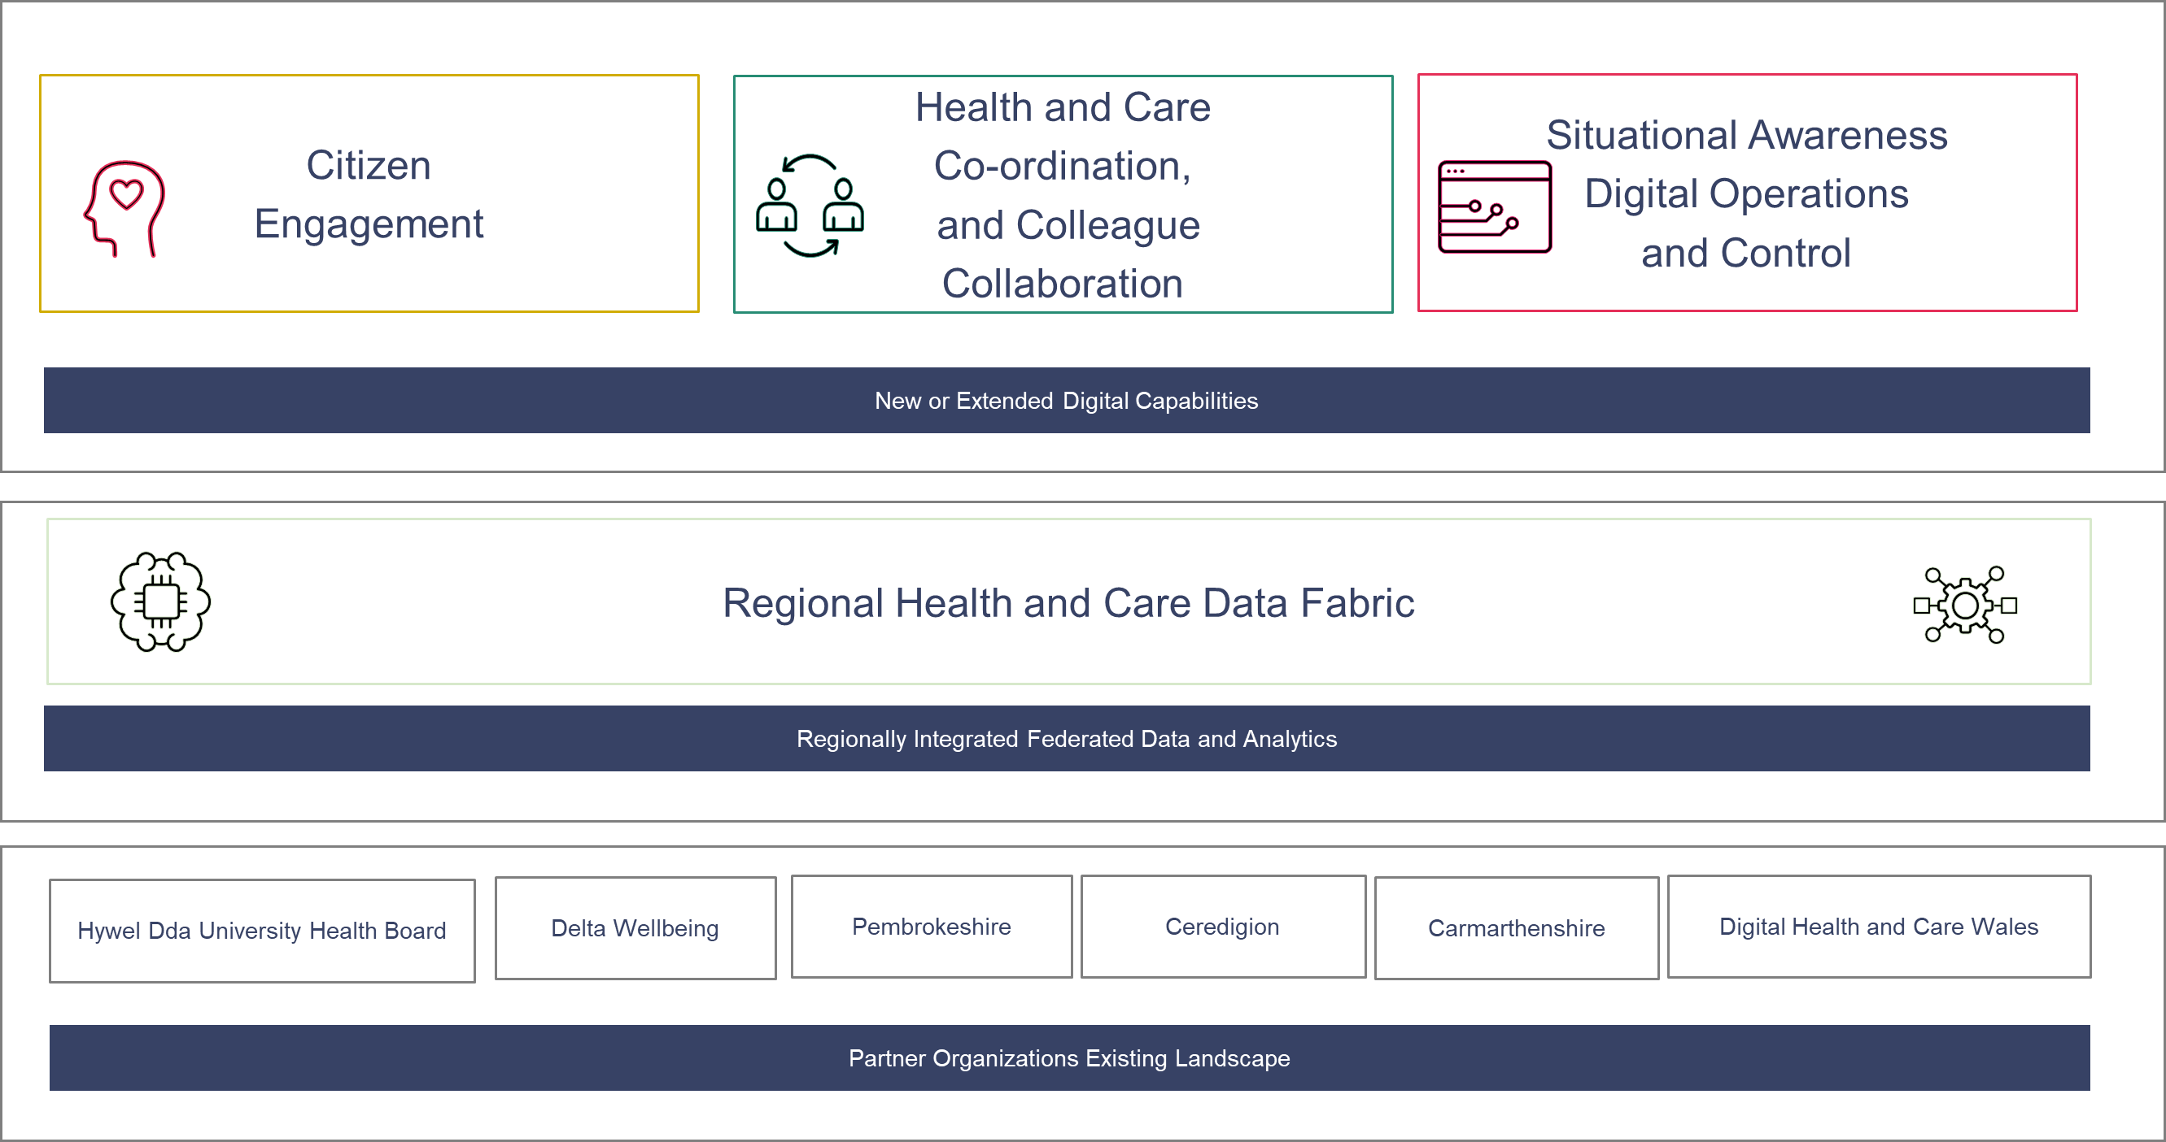
Our alignment with a regional architecture to support integrated health and care
We created a digital architecture for West Wales that takes a first principles view of the challenges we face and identifies the core digital capabilities we require to meet our strategic ambition and improve health and care services for our citizens.
We have used this model to
Present and understand current state – where are we today
Identify the gaps or opportunities that are aligned to our strategic imperatives and value propositions
Present our target state
It is aligned to our strategic imperatives.
Our detailed digital capability model mapped to the current state is shown on the next slide

Slide 8
Key inputs to transformation on a page
34 Strategic Business Imperatives
Stakeholder
Citizen
Employees
Enterprise
01
02
03
04
05
06
07
08
09
10
11
12
13
14
15
16
17
‘Holistic Health
& Care Vision’
‘Common
Priorities’
‘Governing Integration’
‘Positive Regional Outcomes’
‘Resilient Communities’
‘Joining
the Dots’
‘Citizen Healthy Lifestyle’
‘Prevention & Early Intervention’
‘Service
Signposting’
‘Citizen
Experience’
‘Optimise Where
Care is Given’
‘Building
Capabilities’
‘Designing
Roles’
‘New Ways of Working’
‘Enabling
Change’
‘Workforce Sustainability’
‘Operational
Running’
Enterprise
Information
Partners
Solution
18
19
20
21
22
23
24
25
26
27
28
29
30
31
32
33
34
‘Demand, Supply & Configuration’
‘Resource Scheduling’
‘Infrastructure Sustainability’
‘Reducing
Financial Deficit’
‘Citizen
Outcome Measures’
‘Information
Hub’
‘Real-Time Medical Dashboard’
‘Ecosystem
Outcome Measures’
‘Extending the Ecosystem’
‘Partner
Collaboration’
‘Benefits
Realisation’
‘Digitally
Enabled’
‘Tech-Enabled Operations’
‘Community
Data’
‘Easy to
Use Solutions’
‘Patient Recovery Flow’
‘Data Protection
& Use’
4 Core Digital Pillars
4 Delivery Workstreams
Citizen Engagement
Health and Care Coordination and Collaboration
Situational Awareness – Digital Operations and Control Centre
Regional Data Fabric
Citizen Experience
& Engagement
CITIZEN ENGAGEMENT AND SIGNPOSTING
PATIENT FLOW AND MONITORING
Front Line
Service Delivery
FRONT LINE WORKERS
WORKFORCE / ASSET SCHEDULING AND MANAGEMENT
10 Delivery Projects
EMPLOYEE ENGAGEMENT
Enterprise
Technology
SINGLE CITIZEN / PATIENT VIEW
ENTERPRISE INFORMATION
IT SYSTEM RATIONALISATION
Change & Programme Management
REGIONAL OPERATING MODEL, ROLES AND GOVERNANCE
CHANGE AND BENEFITS REALISATION

Slide 9
Next Steps
In order to accelerate the digital transformation journey, we will need to commit to the following:
Re-establish the Regional Digital Transformation Group – with suitable Executive Leadership, Governance, and attendance with a number of sub-groups to drive through the proposed workstreams
Establish digital enablement roadmap delivery governance, key partners and procurement mechanisms across the region, with an agreed Regional Digital Strategy
Develop and leverage key technology capabilities to support effective simplification, implementation and adoption of new ways of working across people, process and technology for improved health and care outcomes across the region.
Commit to the completion of the Continuity of Care Maturity Model (CCMM). This is a internationally recognised assessment which demonstrates the evolution of communication between clinicians in different settings with limited or no electronic communication to an advanced, multi-organisational, knowledge driven community of care. – Baseline Assessment

